Slide 1



A Victorian Murder Mystery
Can you solve the crime?

Slide 2
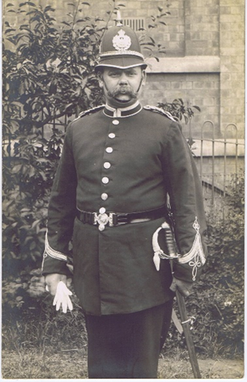
Meet the OIC
A body was discovered by PC 5774 Daniel Long, on foot patrol, at 02:17am, on Wednesday 16 January 1889. The officer saw that the front door of the property had been forced open and went inside to investigate.

Slide 3
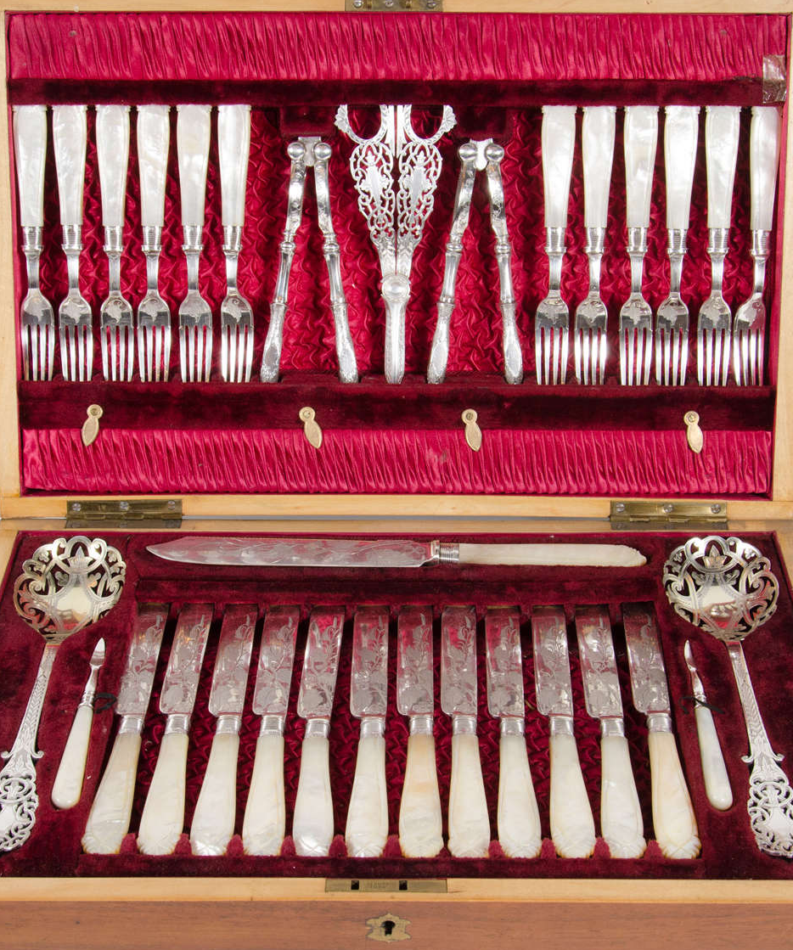
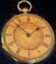
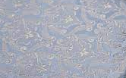
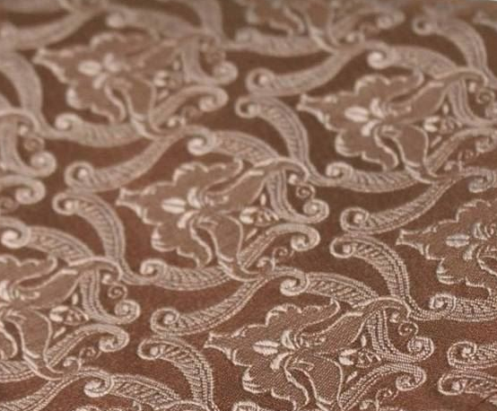
What did he find?
The homeowner, a wealthy gentleman, aged 54 years had been killed in bed in his home in Worcester Street in the city centre and his gold pocket watch, several silk handkerchiefs and a canteen of fine quality silver cutlery had been stolen.

Slide 4
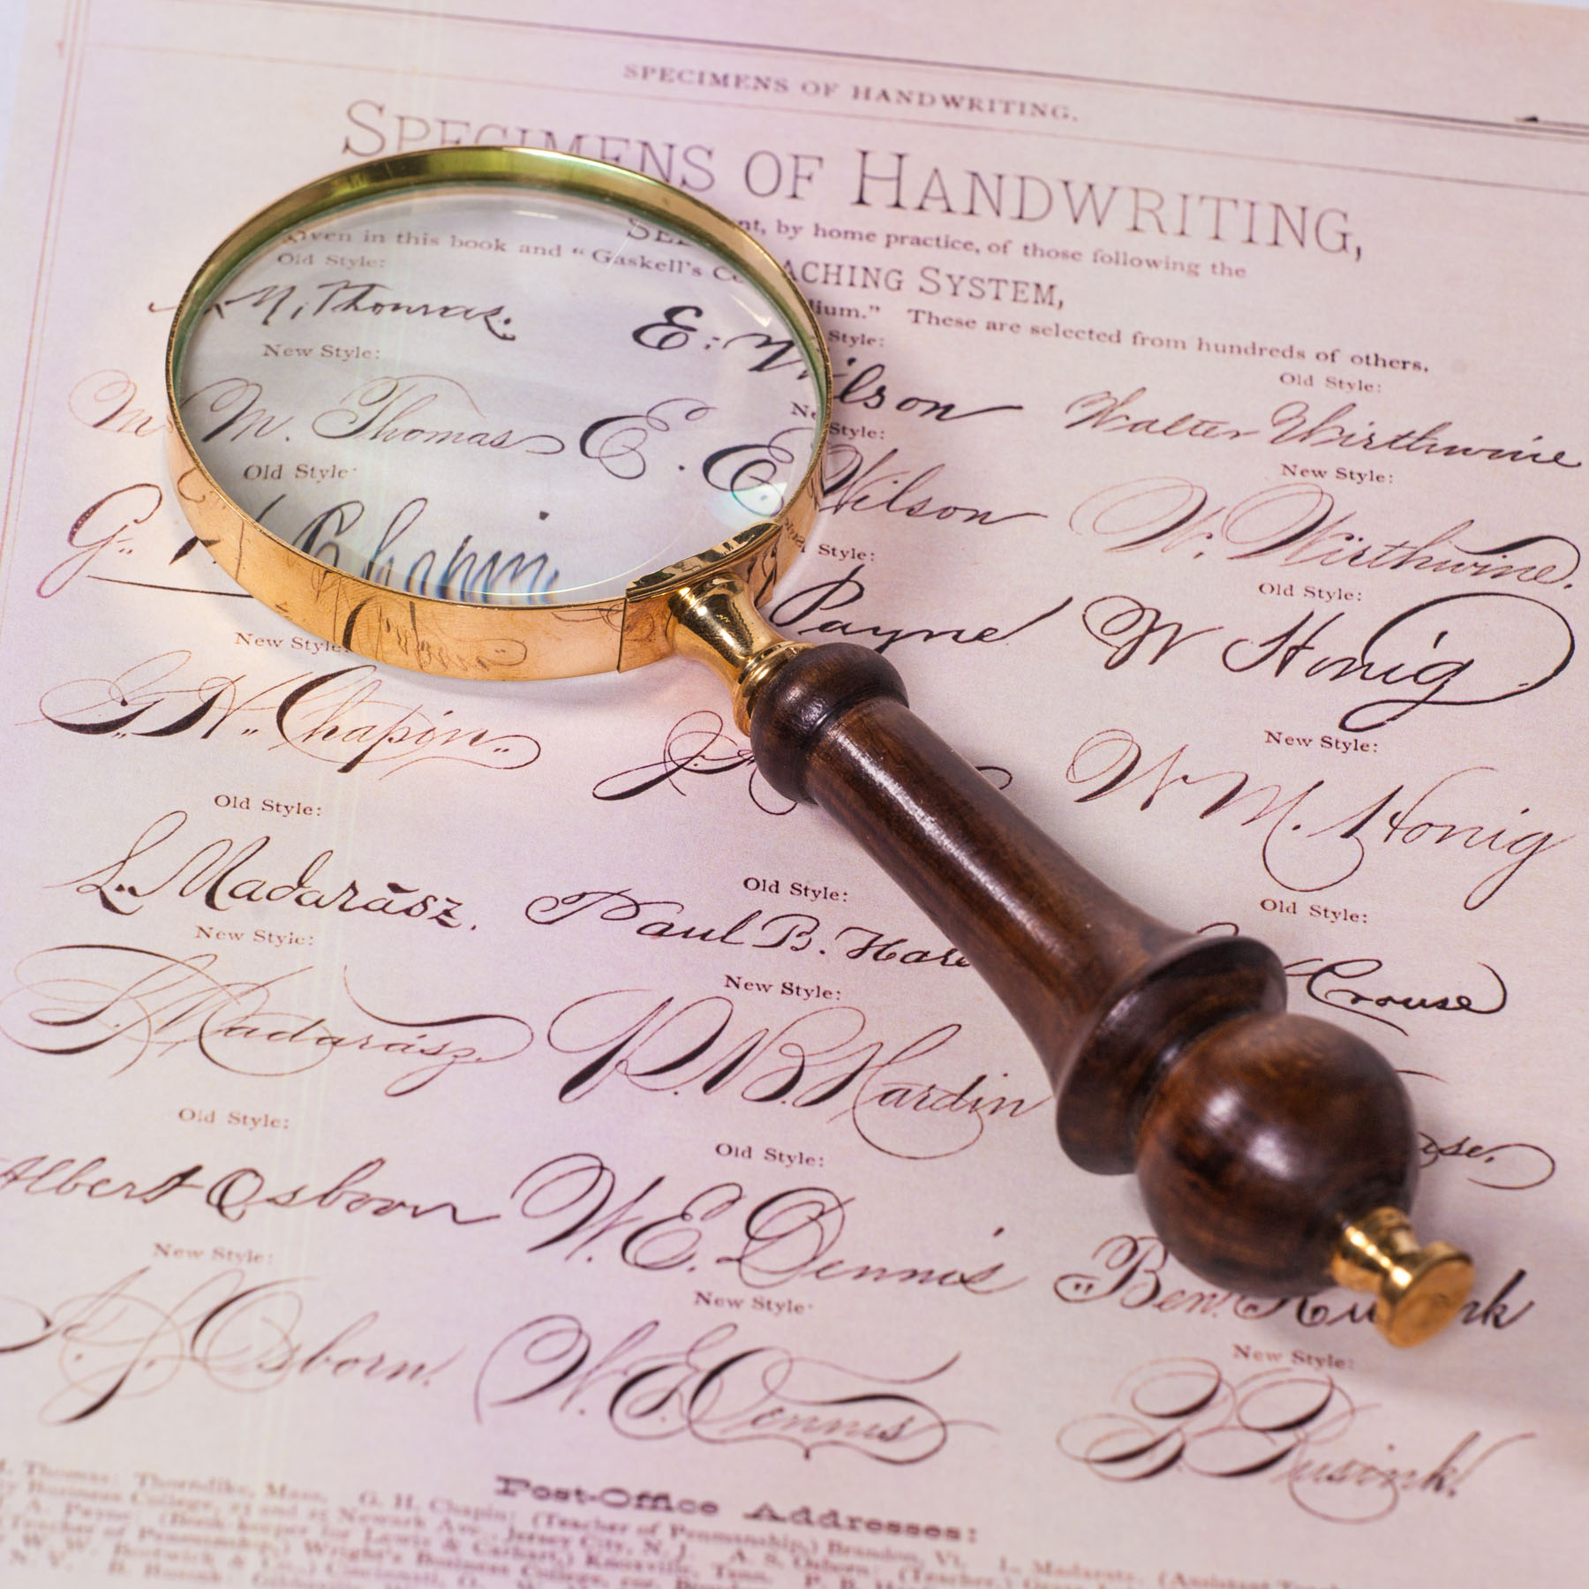
Who was the killer?
PC Long was not able to locate any witnesses to this heinous crime, nor did he find any enemies of the hapless victim.
He did gather as much evidence as he could, however.
Can you use this, along with modern methods of forensic detection to identify the killer?

Slide 5
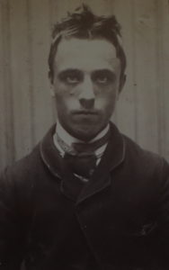
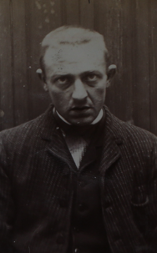
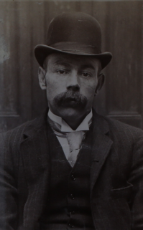
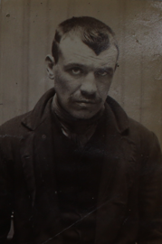
Who were the suspects?
To help us, PC Long has pulled the records of the four most notable street criminals working in the local area.
They are:
Henry Cartwright;
George Wilding;
William Townley
Benjamin Jameson.

Slide 6
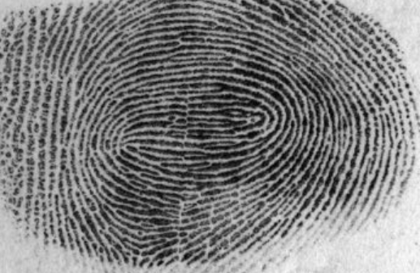
Exhibit A
What evidence is there?
A partial right thumbprint was found on the handle of the silverware cabinet.

Slide 7
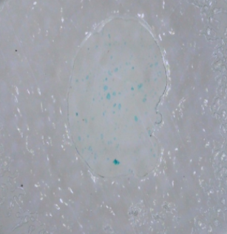
What evidence is there?
Exhibit B
Some small traces of organic matter were found on the ground in the victim’s bedroom and believed to be from the intruder’s boots.

Slide 8
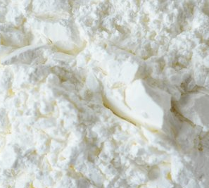
Exhibit C
What evidence is there?
Trace amounts of an unknown white powder were found on the floor in the doorway between the dining room and kitchen.

Slide 9


Exhibit D
PC Long also spoke to one of his confidential informants, a woman known only as Miss Terry. She has sent him some information on each of the suspects, but it is all written in the form of riddles.

Slide 10
Exhibit D
Henry Cartwright:
Remmu sehtni
srewol fnus
swor geh.
George Wilding:
8 5
7 18 15 23 19
12 5 5 11 19
1 14 4
16 15 20 1 20 15 5 19
Notes:
2

Slide 11
Exhibit D
William Townley:
He has often tried gardening,
But never succeeds.
So now has a garden,
That is just full of _____.
Benjamin Jameson:
He grows elements in his garden:
Calcium, Boron, Boron, Silver and Einsteinium.
Also, Oxygen, Nickle, Oxygen, Nitrogen and Sulfur.
Notes:
2

Slide 12
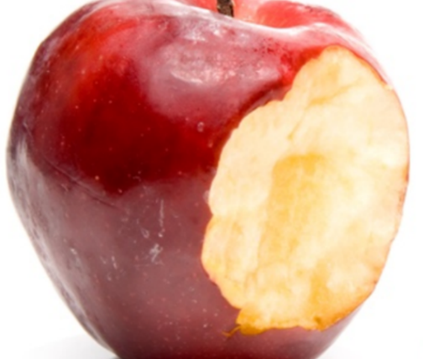
Exhibit E
An apple was found in the dining room of the victim’s house.
It had been taken from a fruit bowl on the table by the offender. He took a bite out of it and then threw it on the floor.

Slide 13
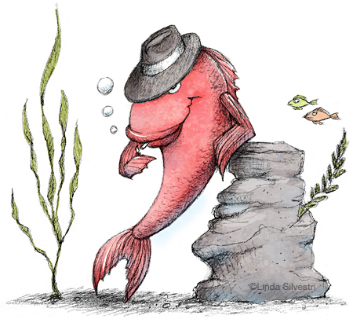
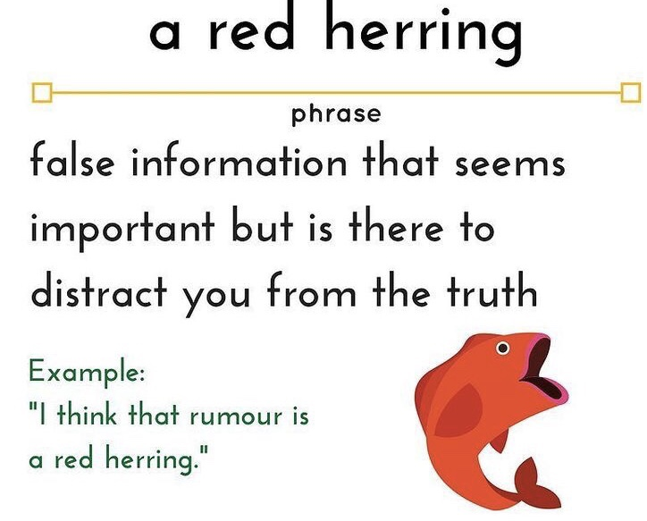
What’s next?
Solve the puzzles.
The clues will lead you to the killer.
Be careful, one or more clues might be a red herring!

Slide 14
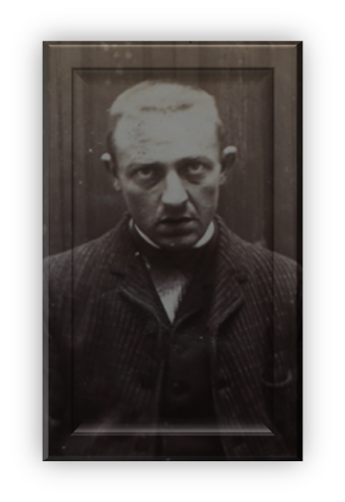
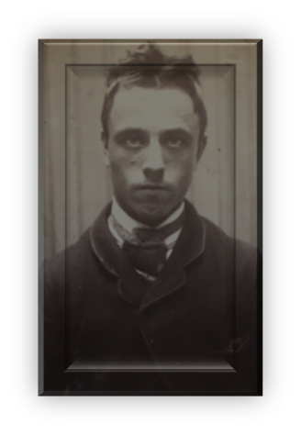
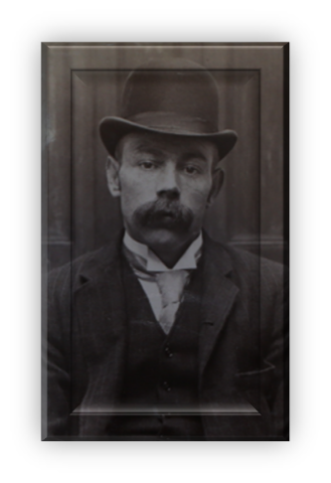
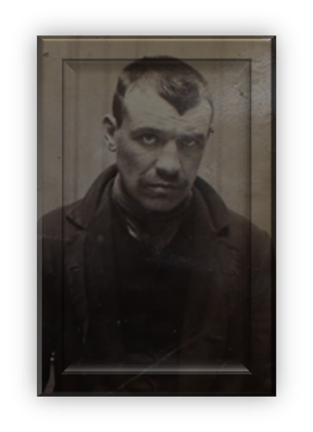
Can you identify the killer?

